Slide 1
Reinforcement Learning for trading

Slide 2
What is Reinforcement Learning?
To train a system (an agent) to have some “desirable” behavior for some “task”, we let the agent learn by doing the task step by step (even though initially the agent does not know what to do and may just give random actions).
After completing every single step, we (the environment) do the following:
reward the agent (by giving some points) if its action taken for this step is “desirable”
punish the agent (by taking away some points) if the action is not “desirable”
tell the agent the new “state” in the environment after its action.
The agent is running some algorithm such that depending on the reward/punishment it gets, it changes its behavior (by changing, for example, an action table, some decision rules, neural networks, …) hoping to make some better move when seeing similar situation later.

Slide 3
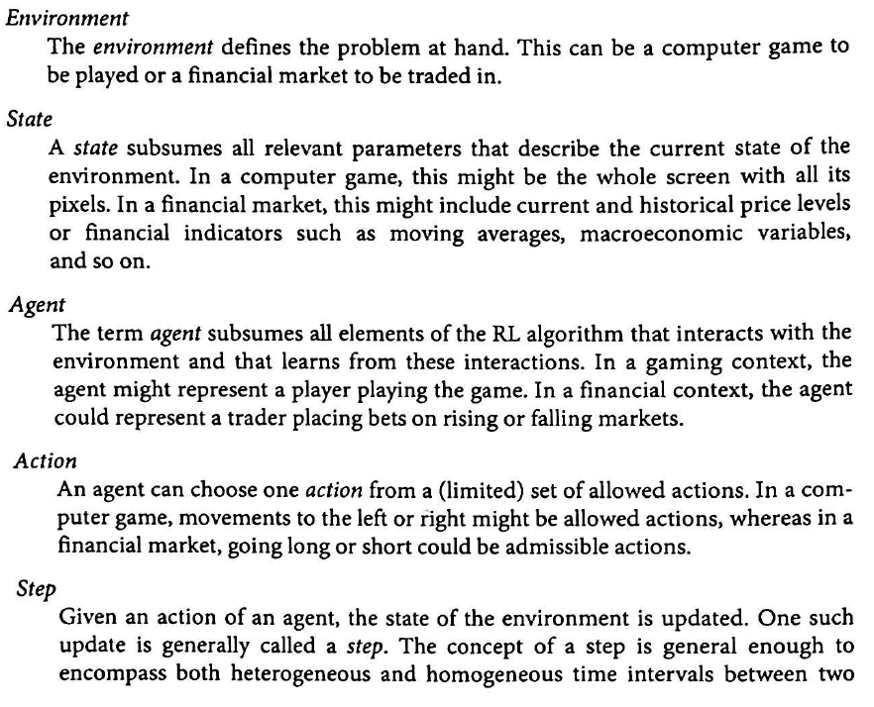
Some important concepts/terms for RL

Slide 4
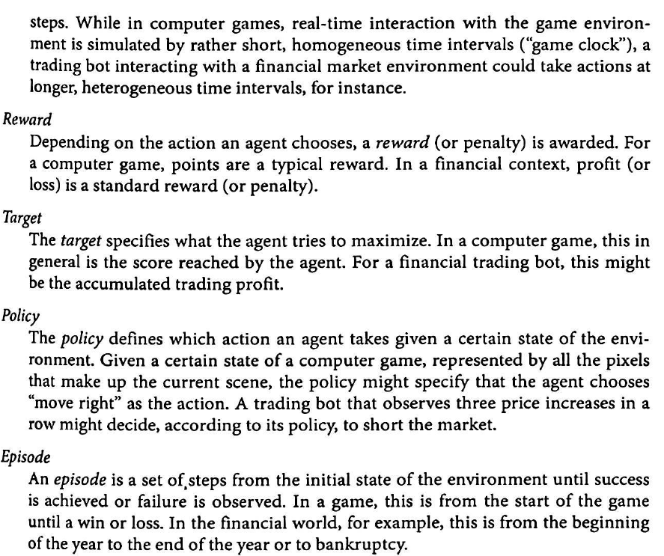

Slide 5
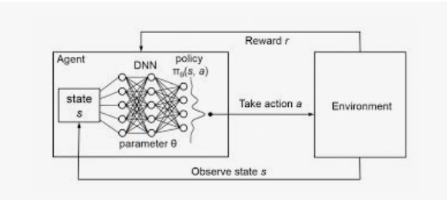
A common picture used to describe RL
Running some
RL algorithm
Agent

Slide 6
One obvious problem for the design and testing of RL algorithm
To illustrate how reinforcement learning work, we need to provide an “environment” before we can design, implement and test our RL algorithms, or compare different RL algorithms.
Since we may test various RL algorithms hundreds, or even thousands of times, it is not feasible to wait for the environment’s real responses.
Fortunately, there are already some comprehensive software libraries that provide tools to simulate various environments for RL research.

Slide 7
gym from OpenAI
This is one of the most popular library for simulating environments for RL research

Slide 8
OpenAI
OpenAI is an AI research laboratory found in late 2015 by Elon Musk, Sam Altman and others.
Its stated goal is to promote and develop friendly AI that benefits humanity as a whole.
OpenAI is considered as a competitor of Goolge’s DeepMind.

Slide 9
Gym
Gym is an open source Python library developed and maintained by OpenAI. It is for developing and comparing reinforcement learning algorithms by providing a standard API to communicate between learning algorithms and environments, as well as a comprehensive set of environments compliant with that API.
You may have a look at some of the environments here
https://gym.openai.com

Slide 10
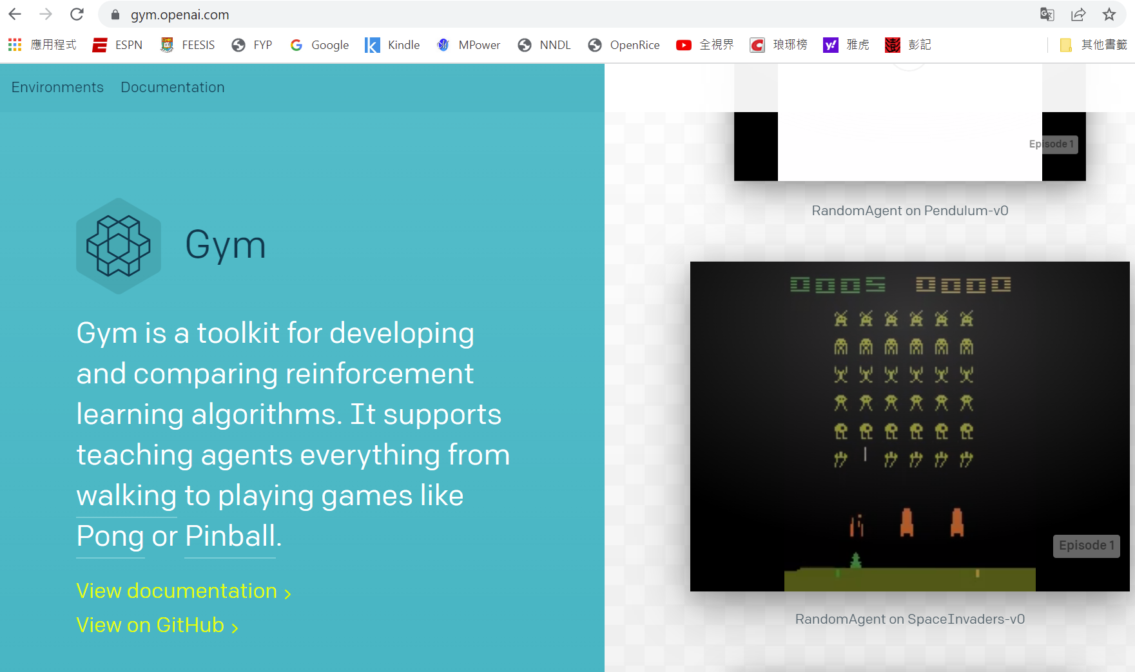
To get some ideas on the environments support by Gym,
try https://www.gymlibrary.ml

Slide 11

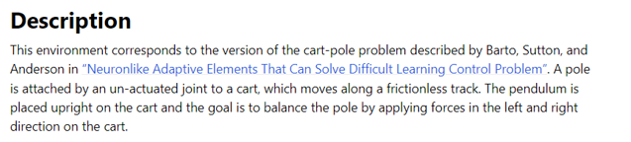
An example from Gym: Cart Pole

Slide 12
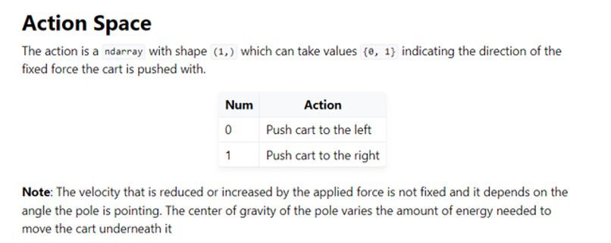
An example from Gym: Cart Pole

Slide 13
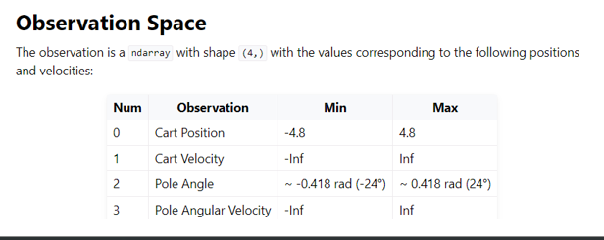
An example from Gym: Cart Pole

Slide 14
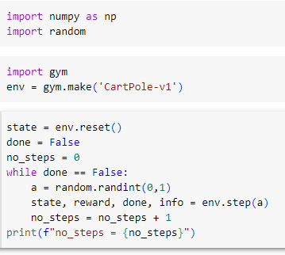
A simple example: Taking random actions

Slide 15
A simple and very popular RL algorithm: Q-learning
Q-learning is based on Bellman’s principle of optimality:
An optimal policy has the property that whatever the initial state and initial decision are, the remaining decisions must constitute an optimal policy with regard to the state resulting from the first decision

Slide 16
Q-learning
Idea
We try to learn the Q-value Q(S, A) for all possible states S, and actions A. Intuitively, Q(S, A) tells us how good it is if we take action A when we are current in state S.
Initially, Q(S,A) is assigned an arbitrary number, say 0, and we will improve it during the learning process.
How to learn?

Slide 17
High level idea on how to learn
Suppose when at state S, we have chosen action A and the action moves us to S’.
Suppose there are k possible actions A1, A2, ... Ak. Then, after we move to S’, the next action can be A1, A2,..., Ak. Which one?

Slide 18
High level idea on how to learn
Suppose when at state S, we have chosen action A and the action moves us to S’.
Suppose there are k possible actions A1, A2, ... Ak. Then, after we move to S’, the next action can be A1, A2,..., Ak. Which one?
By Bellman’s principle of optimality, we will choose the one S’ such that Q(S’, A’) = max Q(S’, Ai)

Slide 19
High level idea on how to learn
Suppose when at state S, we have chosen action A and the action moves us to S’.
Suppose there are k possible actions A1, A2, ... Ak. Then, after we move to S’, the next action can be A1, A2,..., Ak. Which one?
By Bellman’s principle of optimality, we will choose the one MA such that Q(S’, A’) = max Q(S’, Ai)
Then, we need to update Q(S, A). How?
Compare Q(S’,A’) and Q(S,A) as we have looked a step further.
If Q(S’,A’) > Q(S, A), then we need to increase Q(S,A) somewhat
If Q(S’,A’) < Q(S, A), we need to decrease Q(S,A) somewhat.

Slide 20
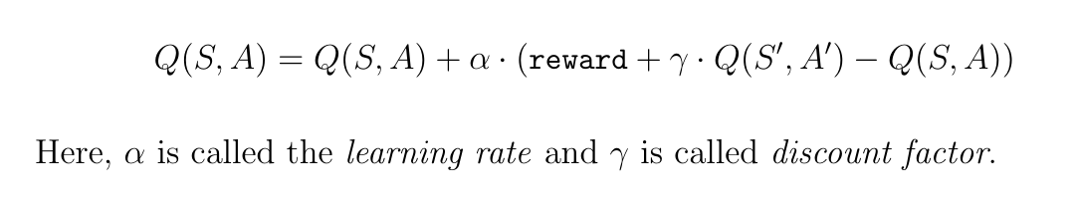
More details
Intuitive reasoning:
Q(S,A) = Q(S,A) + (Q(S’,A’) – Q(S, A))
But this will deterministically set Q(S,A) to Q(S’,A’).
We need some variability, For example,

Slide 21
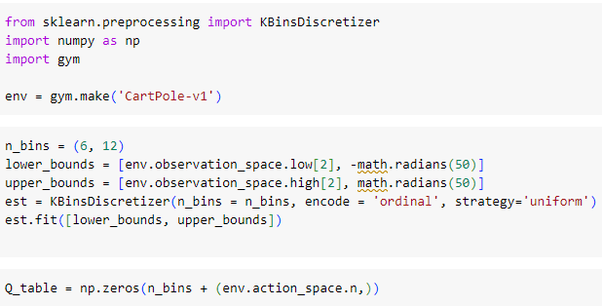
The program

Slide 22
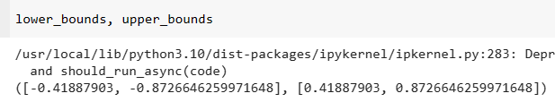
The program

Slide 23
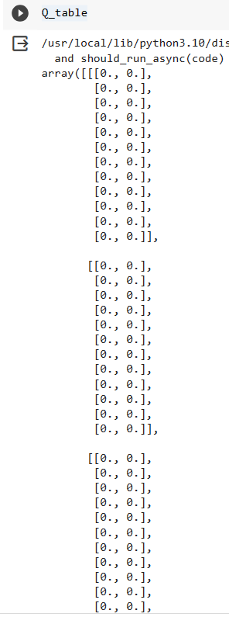

The program

Slide 24
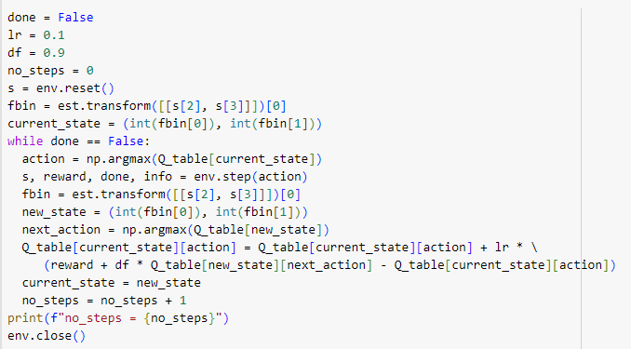
The program

Slide 25
RL for Trading

Slide 26
gym-anytrading
For our purpose (stock trading), we use one of gym environment simulation tools, anytrading.
AnyTrading is a collection of OpenAI Gym environments for reinforcement learning trading algorithms.
More specially, it provides three Gym environments, namely, TradingEnv, ForexEnv, and StocksEnv, and facilitate many useful methods for developers to implement and test RL-based algorithms for trading in the FOREX and the Stock markets.

Slide 27
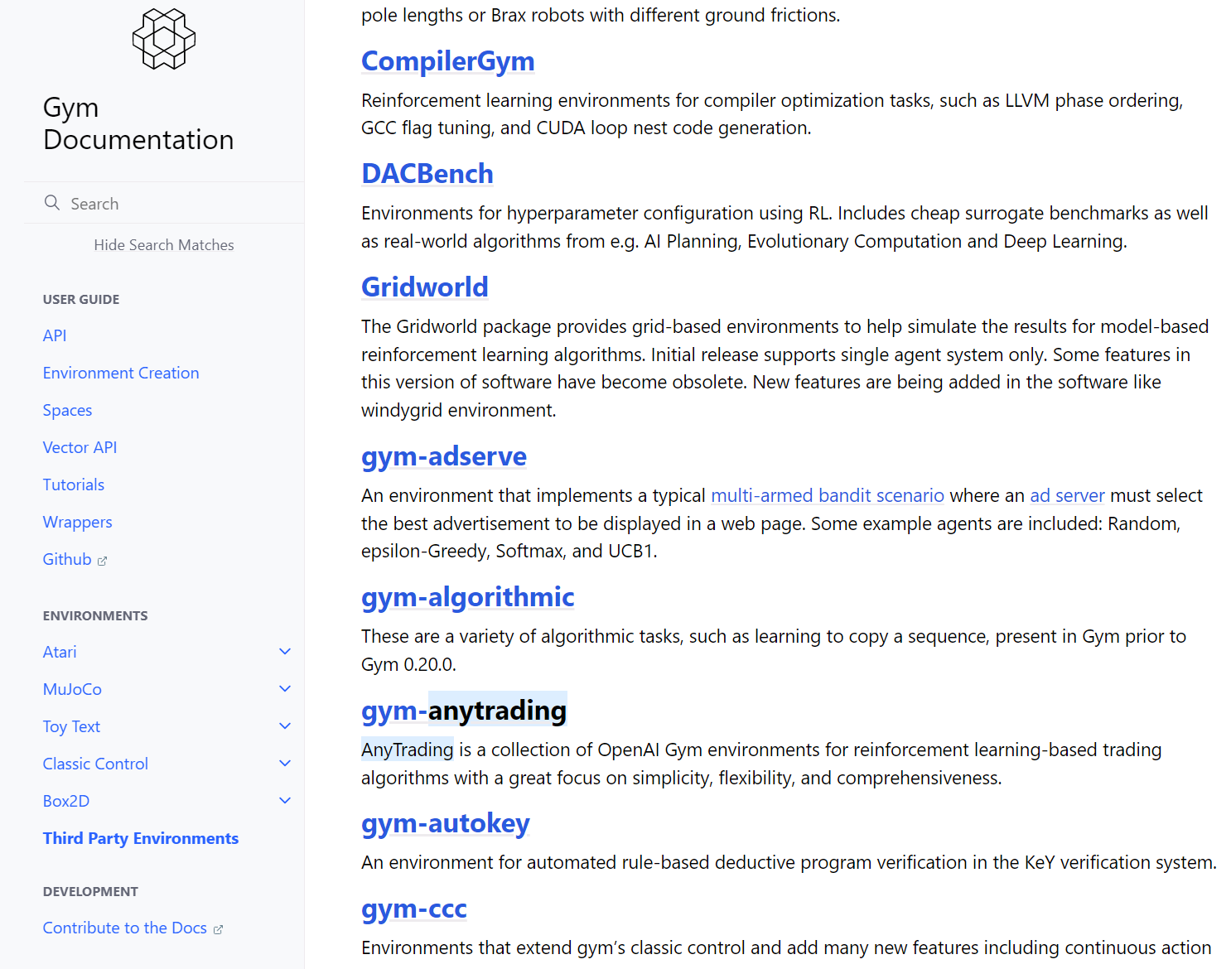

Slide 28
gym-anytrading
Environment Properties
Trading Positions: Short (=0) and Long (=1)
Long position wants to buy shares when prices are low and profit by sticking with them while their value is going up, and Short position wants to sell shares with high value and use this value to buy shares at a lower value, keeping the difference as profit.
Long position ➔ buy action
Short position ➔ sell action.
prices: “Real” prices over time. Used to calculate rewards and final profit.
window_size: Number of ticks (previous ticks + current tick) in an observation.
profit: The amount of units of currency achieved by starting with 1.0 unit (profit = FinalMoney/StartingMoney).

Slide 29
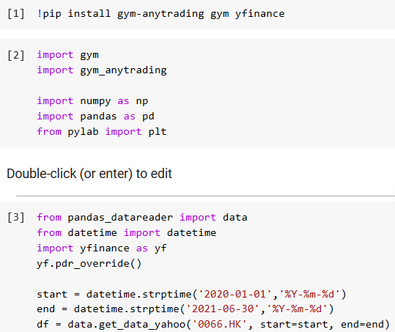

Slide 30
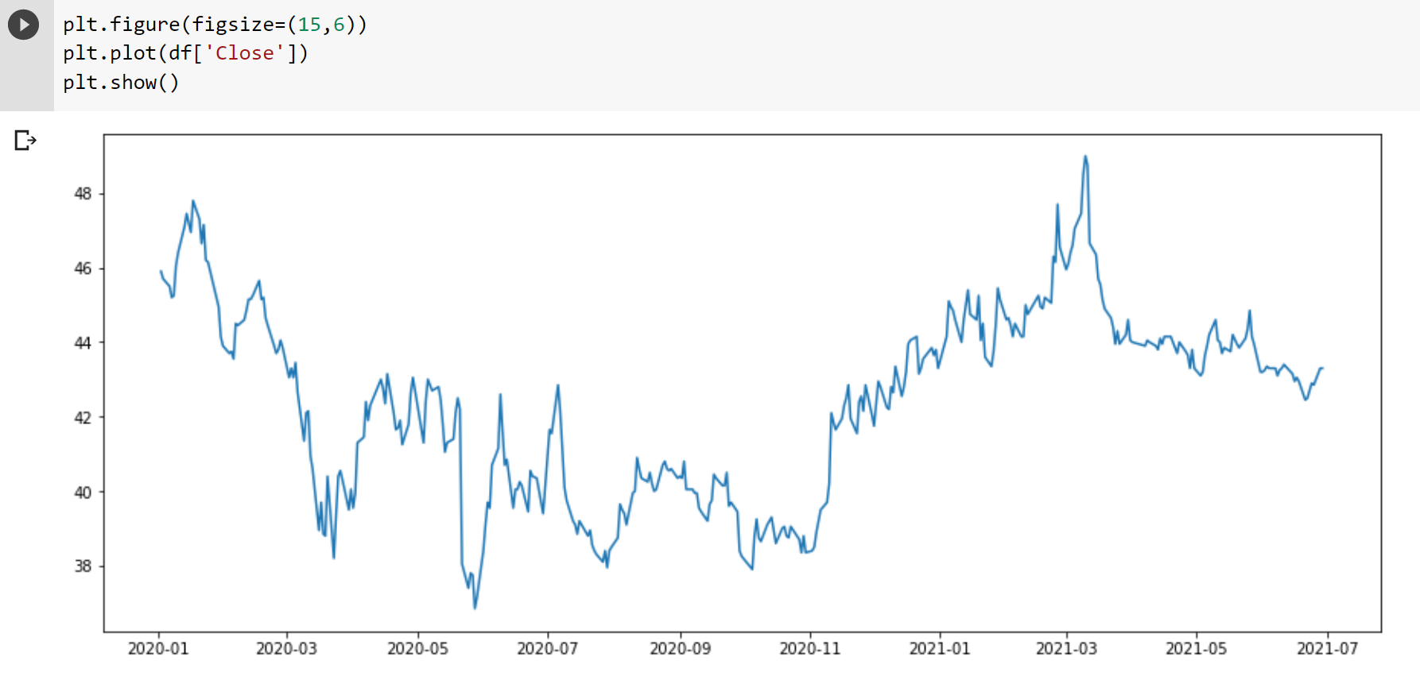

Slide 31
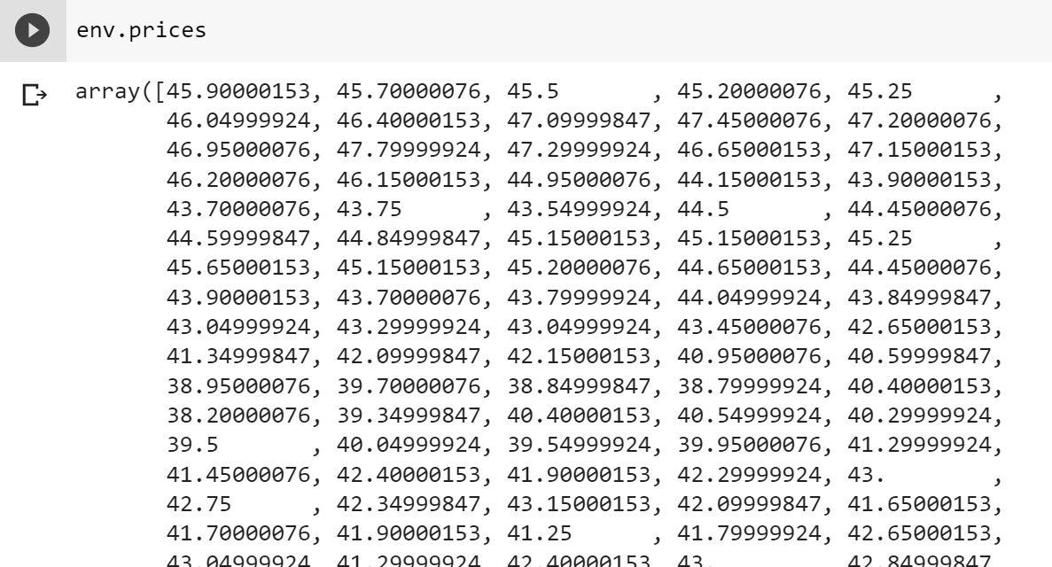
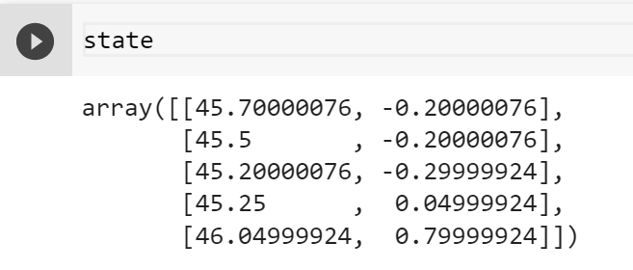
difference
from the
previous day

Slide 32
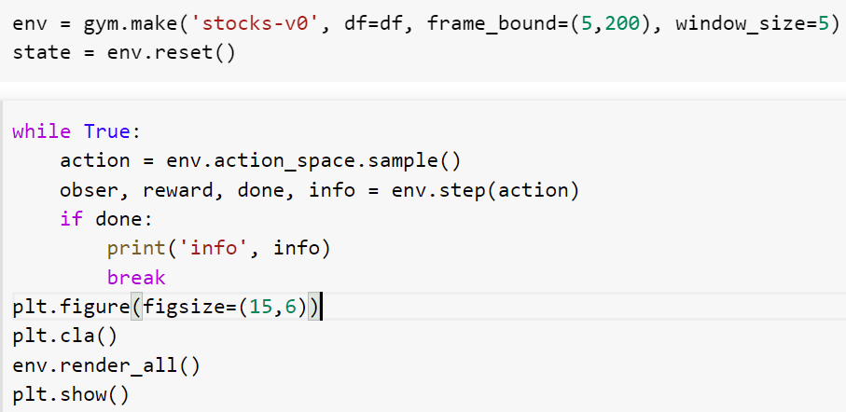

Slide 33
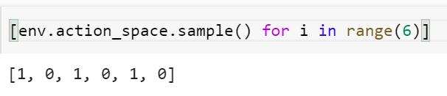
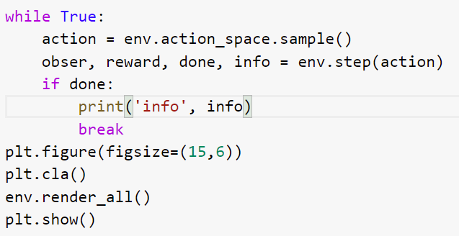

Slide 34
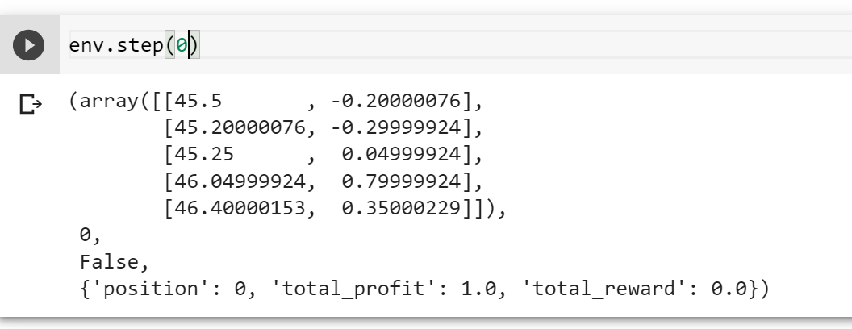

Slide 35
pos 5
pos 200
the prices: x, x, x, x, x, x, x, x, x, …, x
initial state
obser state 1
obser state 2
Note: In this environment, the state is independent of
the actions.

Slide 36
Presumbly, gym-anytrading has designed a way
to calculate the rewards such that an agent that
maximizes the total rewards will get the max
final profit.

Slide 37
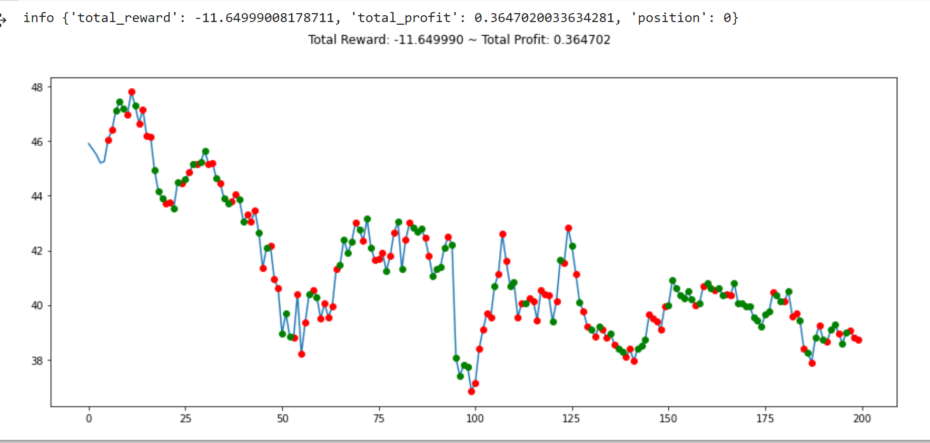
Heavy loss if you
use this policy.
short
long

Slide 38
A library of RL model building algorithms: stable_baselines
It provides many state-of-the-art RL model building algorithms

Slide 39
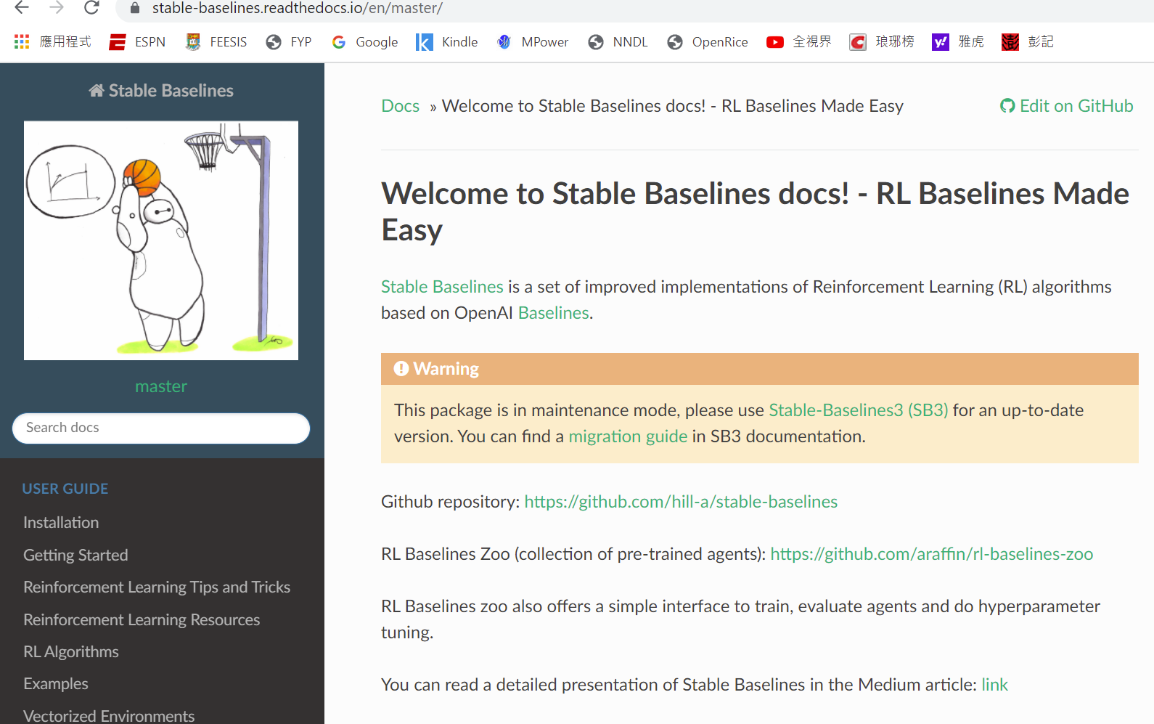

Slide 40
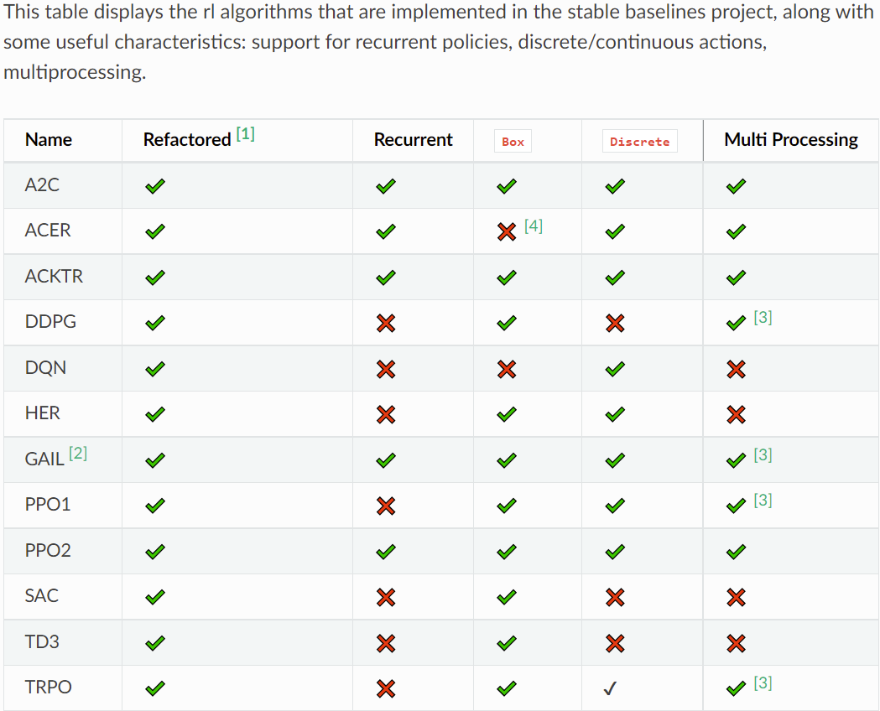
Some RL algorithms in stable-baselines

Slide 41
Some RL algorithms in stable-baselines
Let’s try this one.

Slide 42
A2C: Advanced Actor Critic RL algorithm

Slide 43
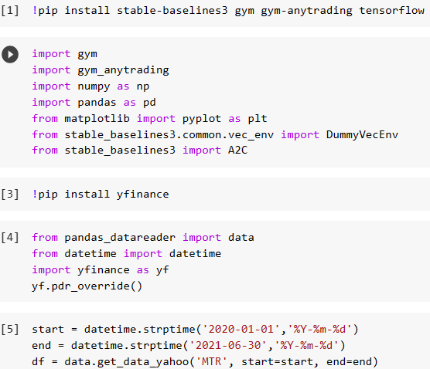

Slide 44
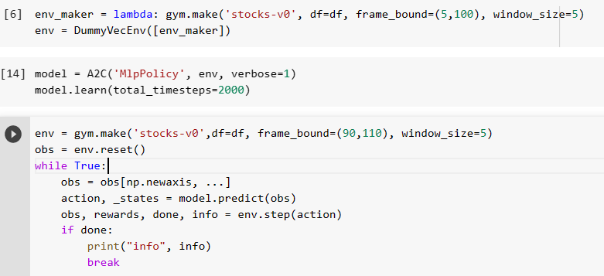

Slide 45
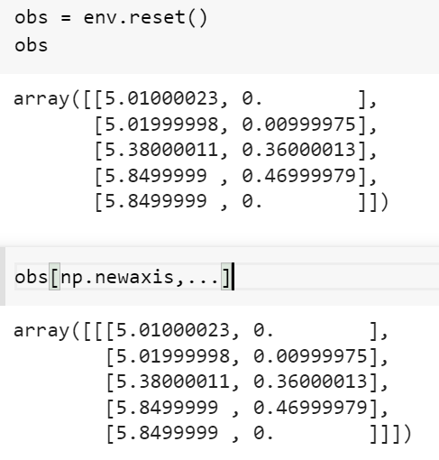

Slide 46
We test the performance
by focus of the stock prices
from pos 90 to 110.

Slide 47
